Slide 1


Quantifying Systemic Risk in Europe
A Bayesian Approach to Map Financial Contagion Through CDS Spreads
Supervisor
Prof. Luca Rossini
Cosupervisor
Prof.ssa Silvia Salini
Graduand
Ivo Bonfanti

Slide 2




Motivations - Public Debt
2007
2022
2019
European public debt has grown a lot in recent decades…
91%
of GDP
Ukraine war
Covid-19
Great Recession
…a debt burdening on future generations more than ever...
62% of GDP
Source: Eurostat

Slide 3








Motivations - Great Recession
…economic growth is cardinal for diminishing countries’ debts…
Greece international bailout
Losses in the value of global listed companies:
€16 trillion (1.5 EU GDP)
90s
2000s
2008
2009
2010
Low inflation
Low interest rates
Ample liquidity
House purchased
Borrower defaults
Subprime mortgage
Foreclosure
Lehman Brothers bankruptcy
and AIG bailout
…but financial instability can become a serious impediment.

Slide 4








Systemic Risk - Financial Contagion
Among the banking instability sources the most prominent is the dense network of connection between intermediaries.
The concurrent failure of a handful of large financial institutions could trigger a severe and pervasive economic crisis.
Potentially having serious negative consequences for the real economy.
«
Regulators and supervisors focused on the micro-prudential supervision of individual financial institutions and not sufficiently on the macro-systemic risks of a contagion of correlated horizontal shocks.
-The Larosière Report, EU, 2009-
«

Slide 5











Credit Default Swap - Functioning
It is a financial derivative working similarly to an insurance contract.
1
P.B.
P.B.
P.S.
P.S.
The contract
is settled.
Notional amount
Reference entity
2
P.S.
P.B.
Contingent event
Fixed premium
Tenor
×
P.B.
P.S.
3

Slide 6




Credit Default Swap - A Proxy for Financial Contagion
The spread incorporates information on how the market perceives the creditworthiness of a reference entity.
Spreads co-movements carry information on the reference entities level of interdependence.
A tightly interconnected network of institutions fosters the rapid spread of financial contagion, posing systemic risk.
Solvency
Spread

Slide 7

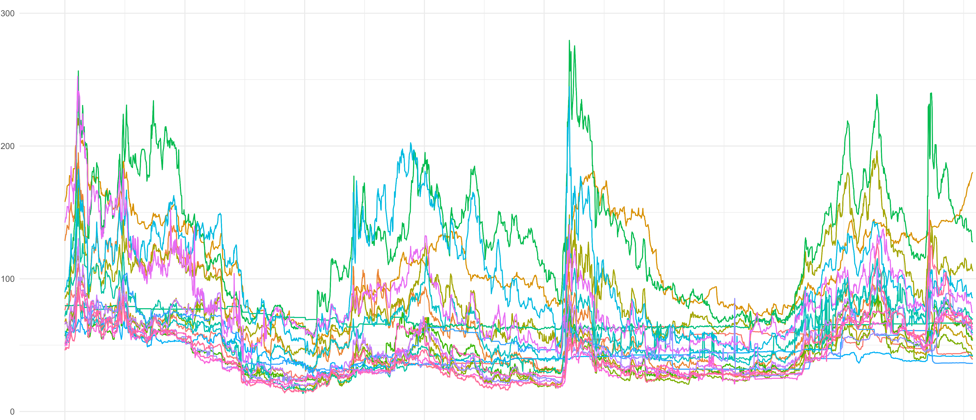





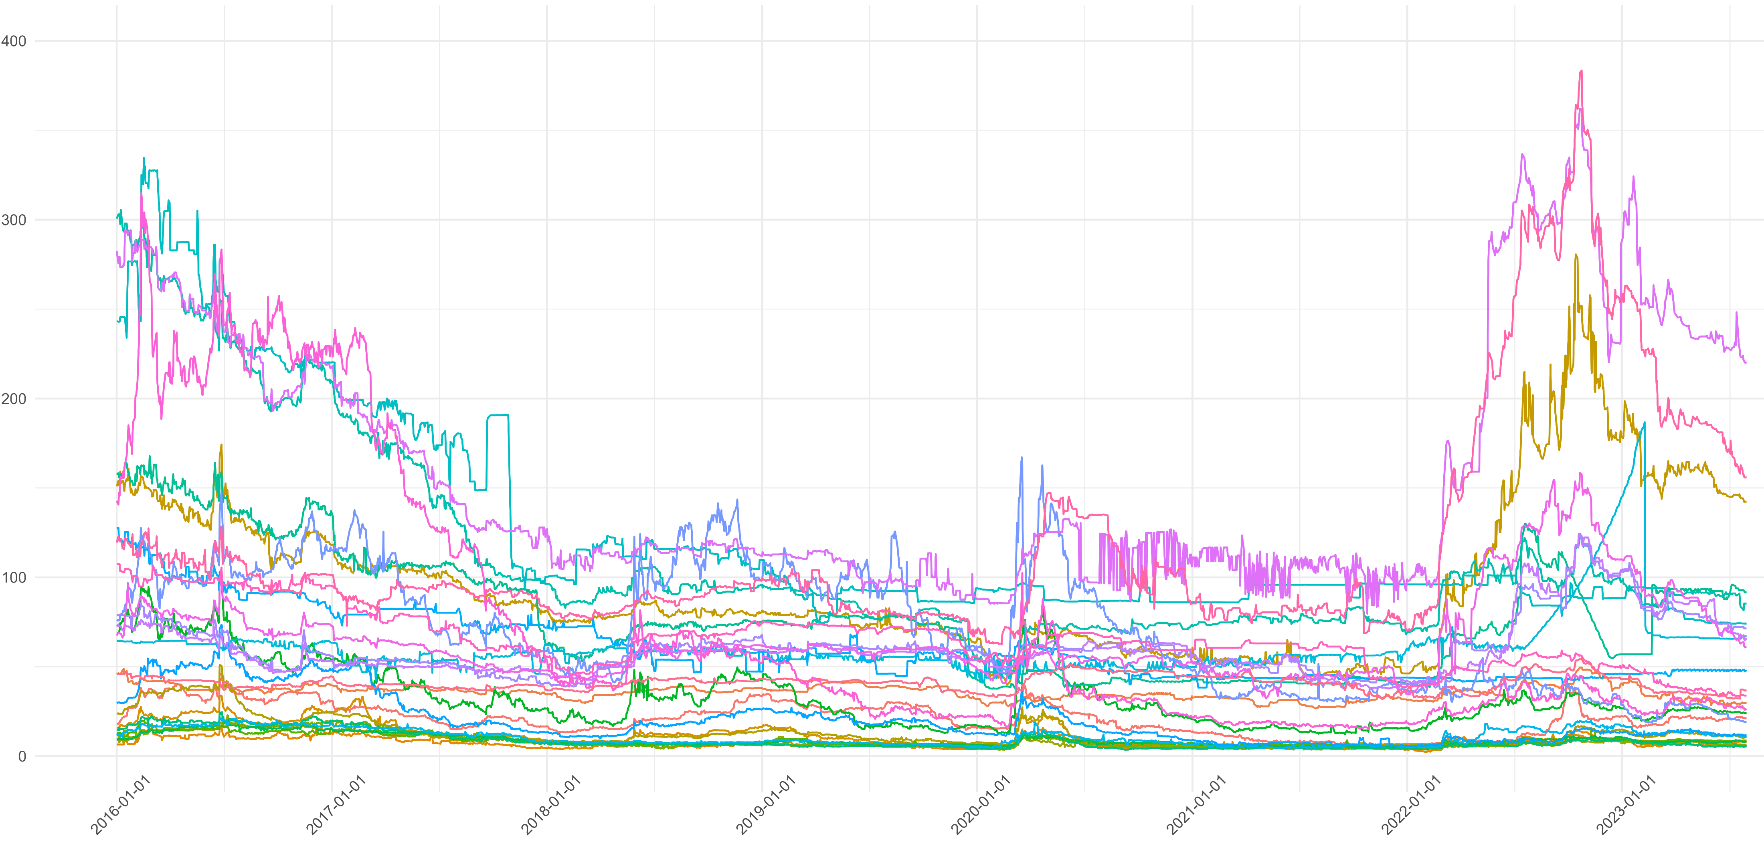
Credit Default Swap – Datasets and Model
[01/01/2016-31/07/2023]
Daily
5Y
21 Banks
29 Countries
VAR
For t=1…T and p=1.
n×1
n×1
n×n
n×1

Slide 8
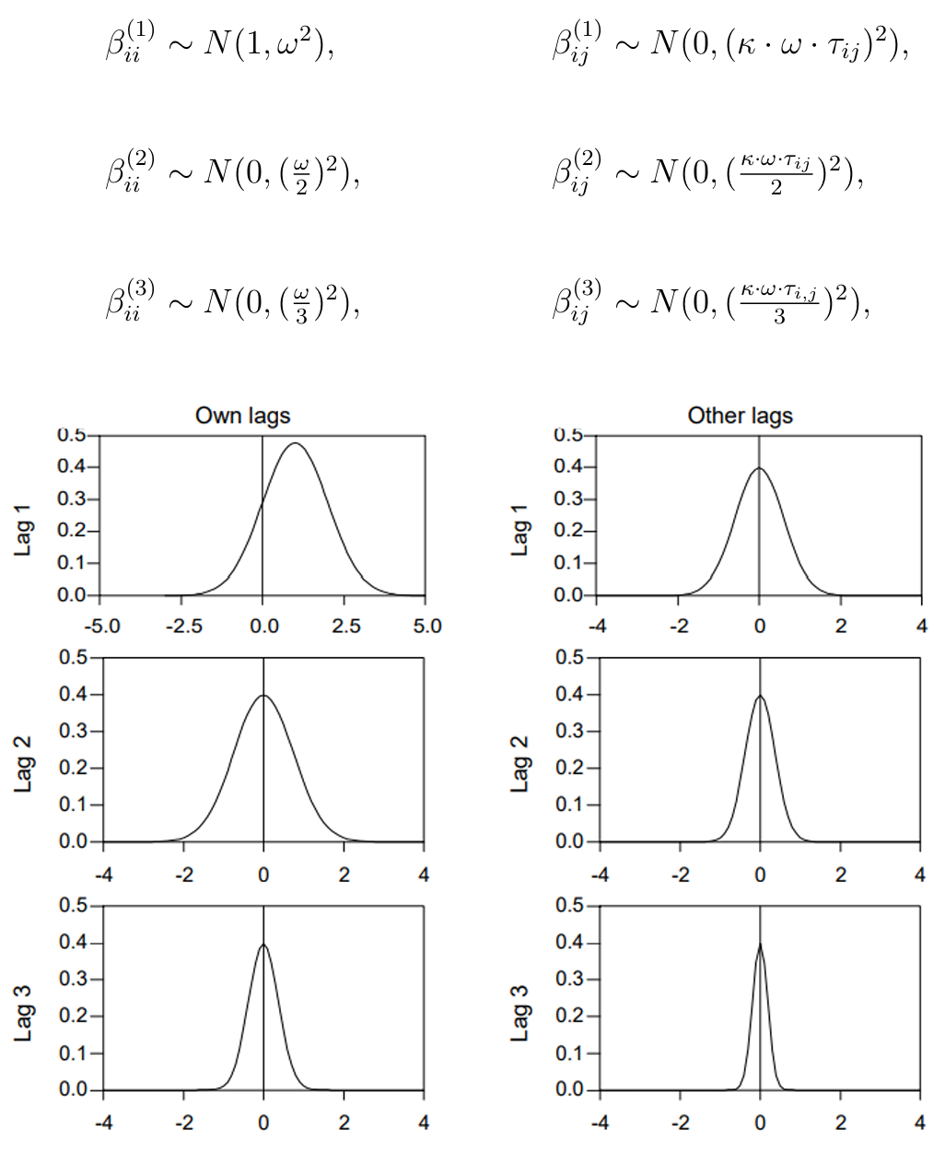
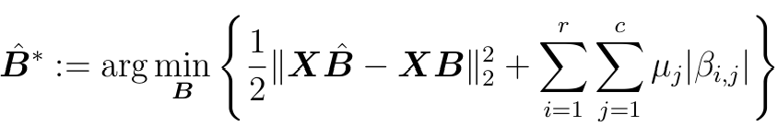
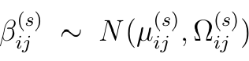


Minnesota Prior – Shrinking Distribution and SAVS
A Bayesian approach to handle the typical VAR overparameterization issue…
Sparse
Design matrix
Penalization term
Shrank
1 1 0 1
1 0 1 1
1 1 1 1
0 1 0 0
1 0 1 0
0 0 0 0
j^{(t−s)}
i^{(t)}
…SAVS is an automated post-processing technique useful for distinguishing between signal and null parameters.

Slide 9
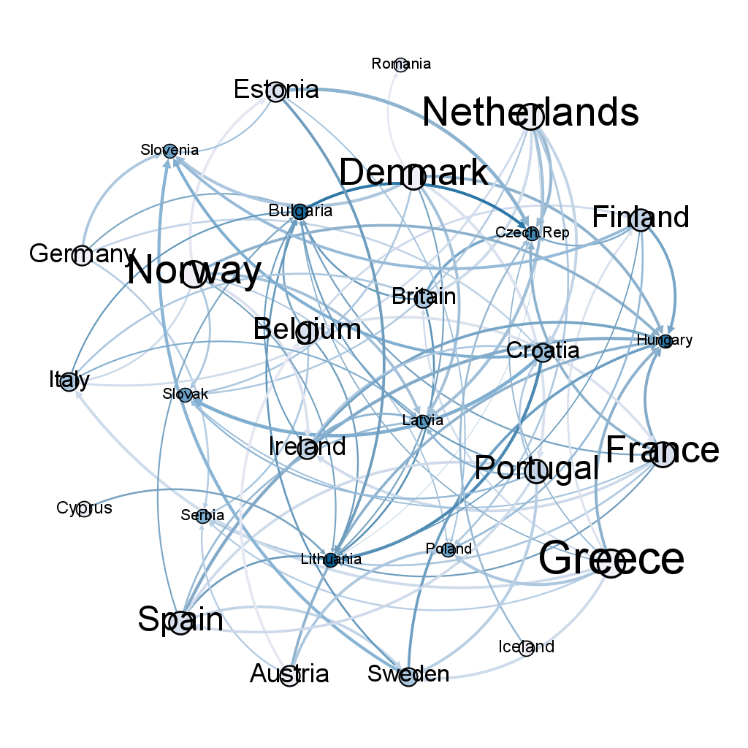
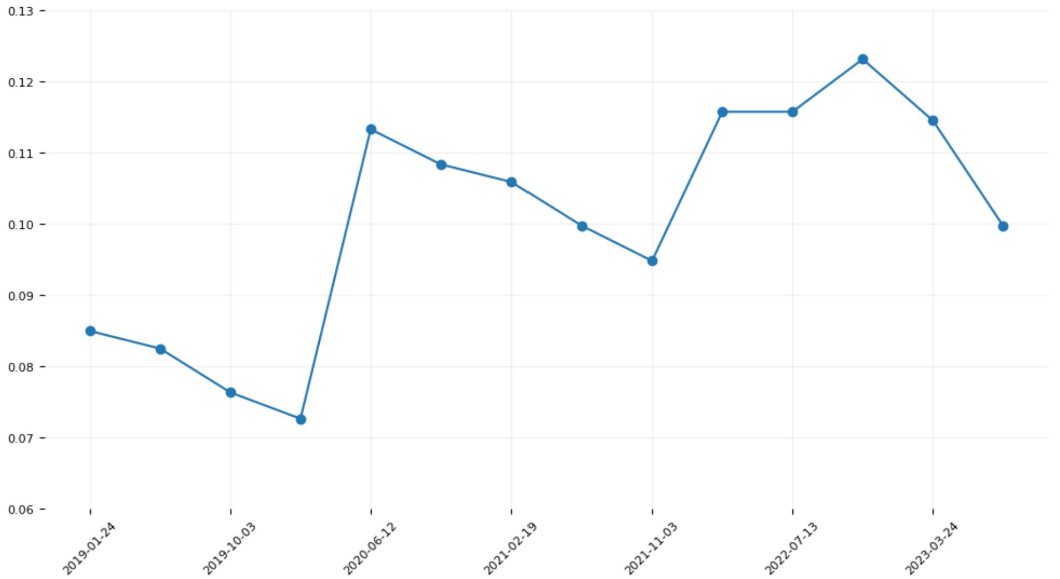


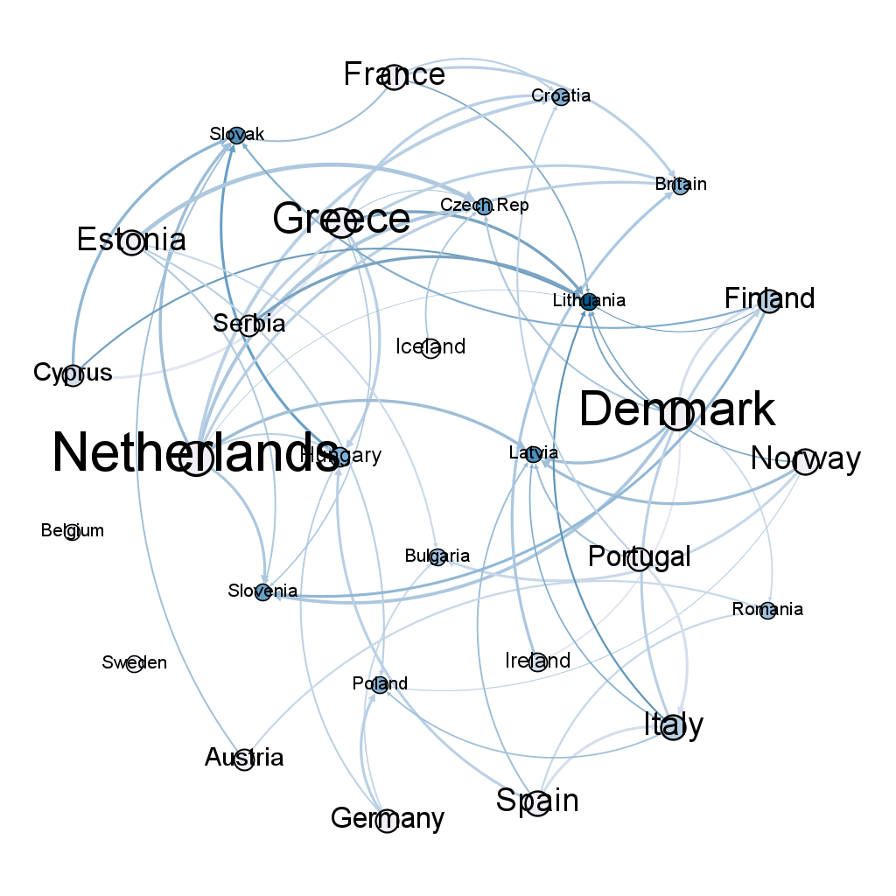
Results - Rolling Window BVAR
01/01/2016
31/07/2023
1
2
90
3
4
14
DENSITIES
791

Slide 10
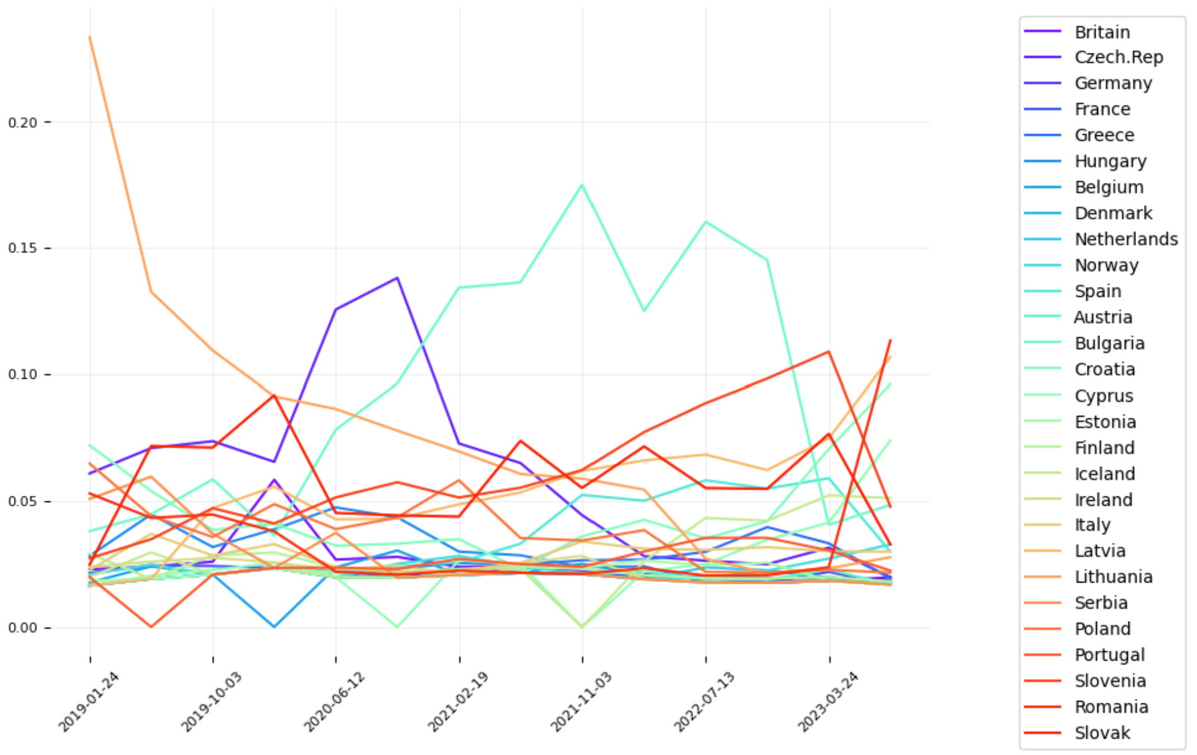
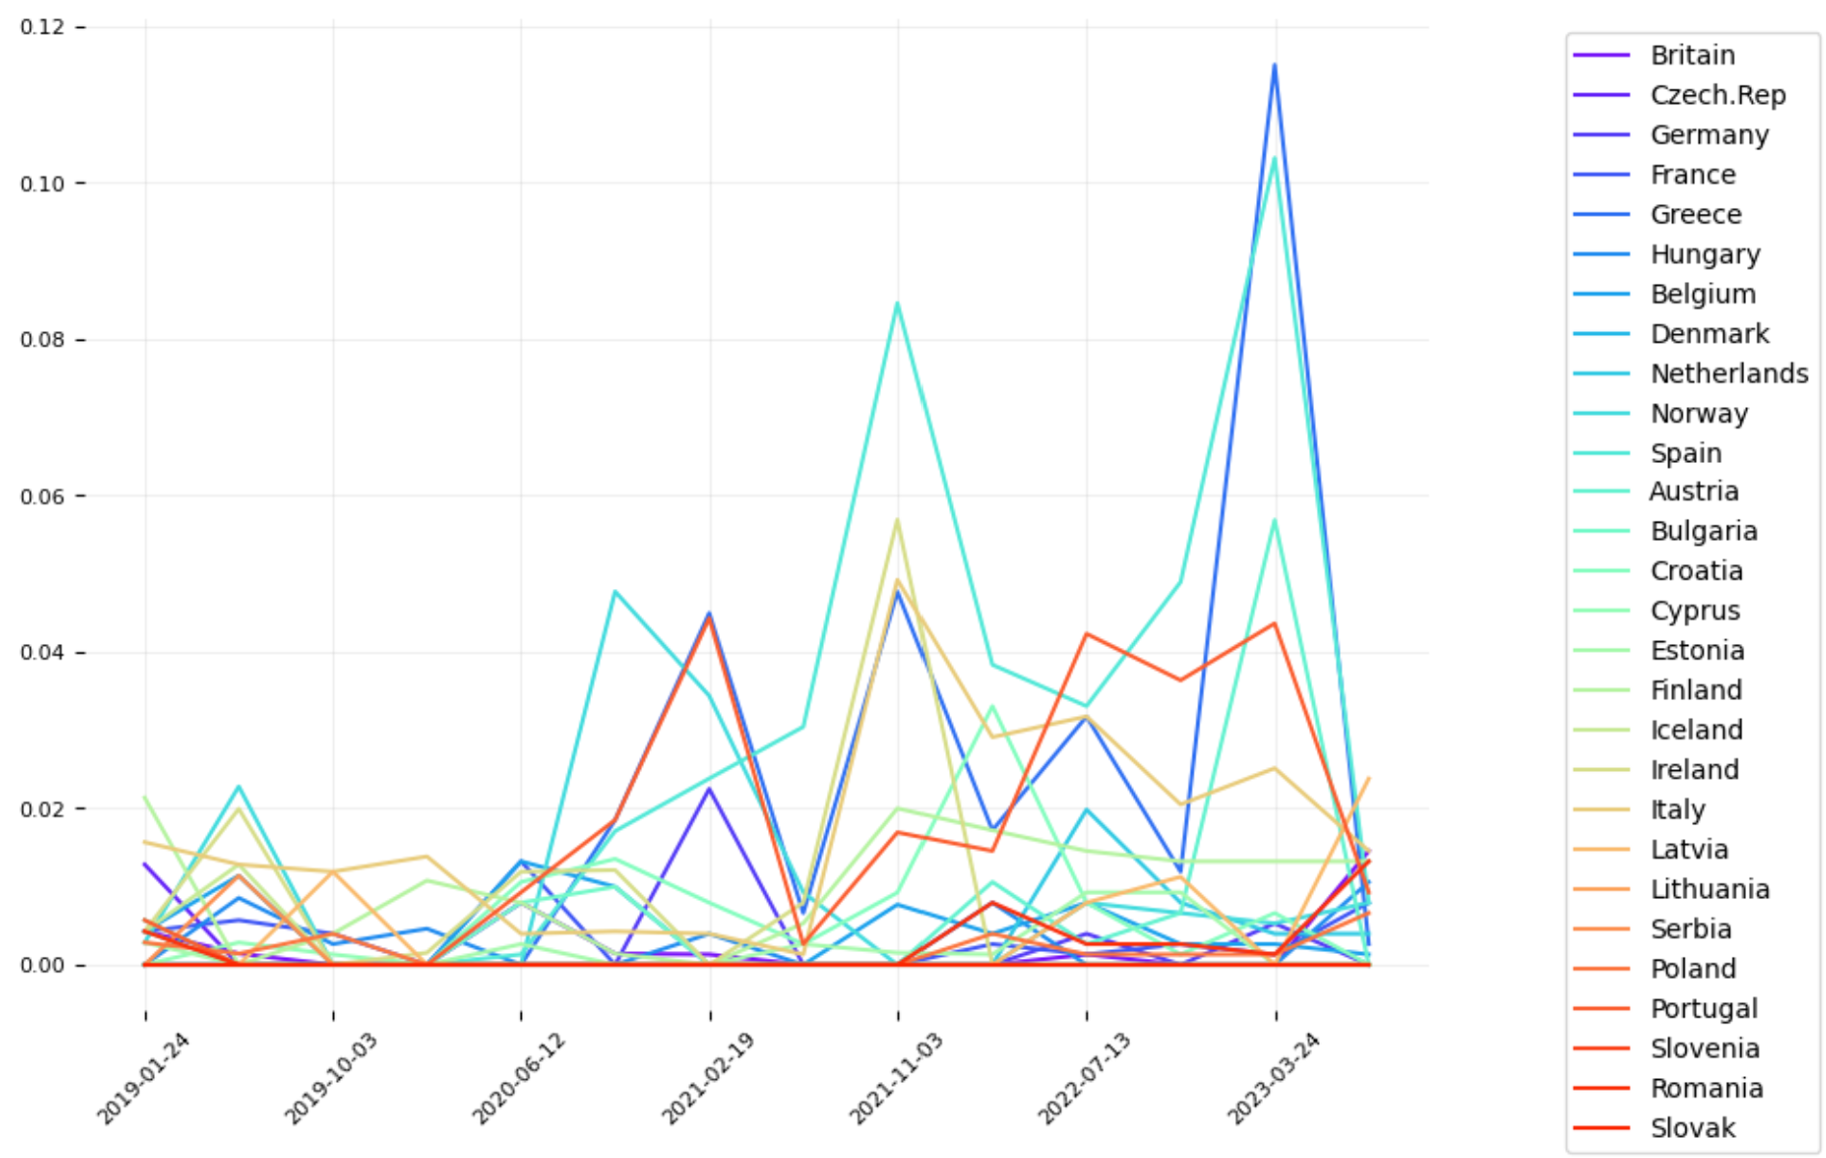
Results – Page Rank and Betweenness Centrality
Nodes with high page rank are the most vulnerable.
1-Greece
2-Spain
Nodes with high betweenness have considerable influence within a network.
Lithuania
Czech Rep.
Bulgaria

Slide 11









Conclusions - Recap
Call for Action
Public Debt
Bayesian
CDS
Networks
0 1 0 0
1 0 1 0
0 0 0 0
Economic
Growth
VAR
SAVS
Interconnectedness

Slide 12

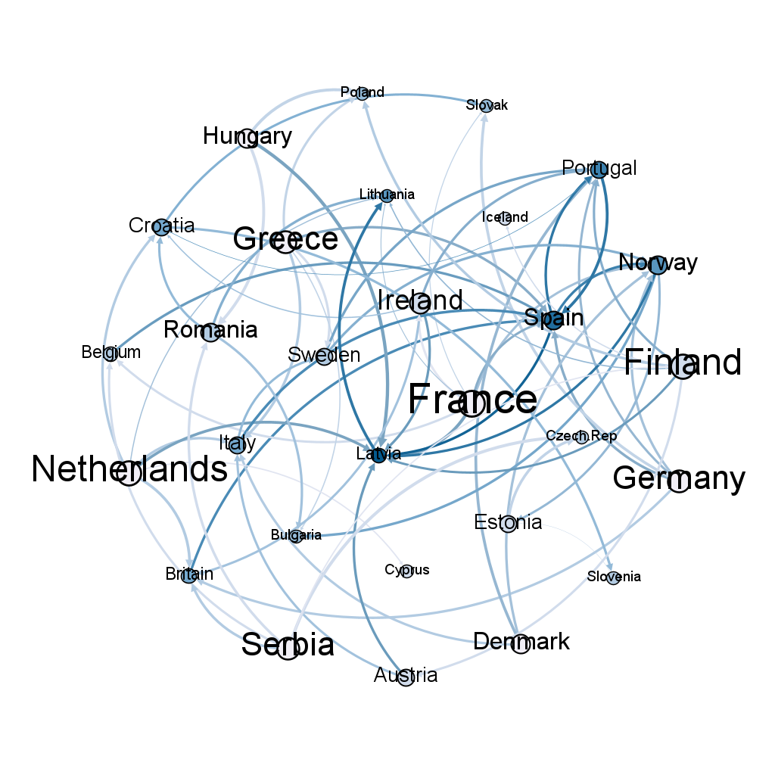
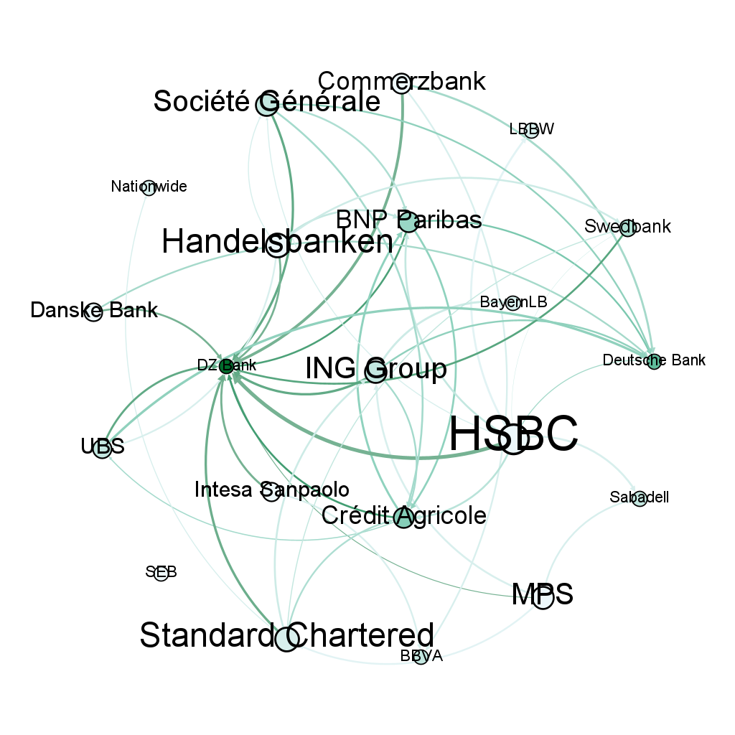
Appendix - Full Period
01/01/2016
-------------
31/07/2023

Slide 13
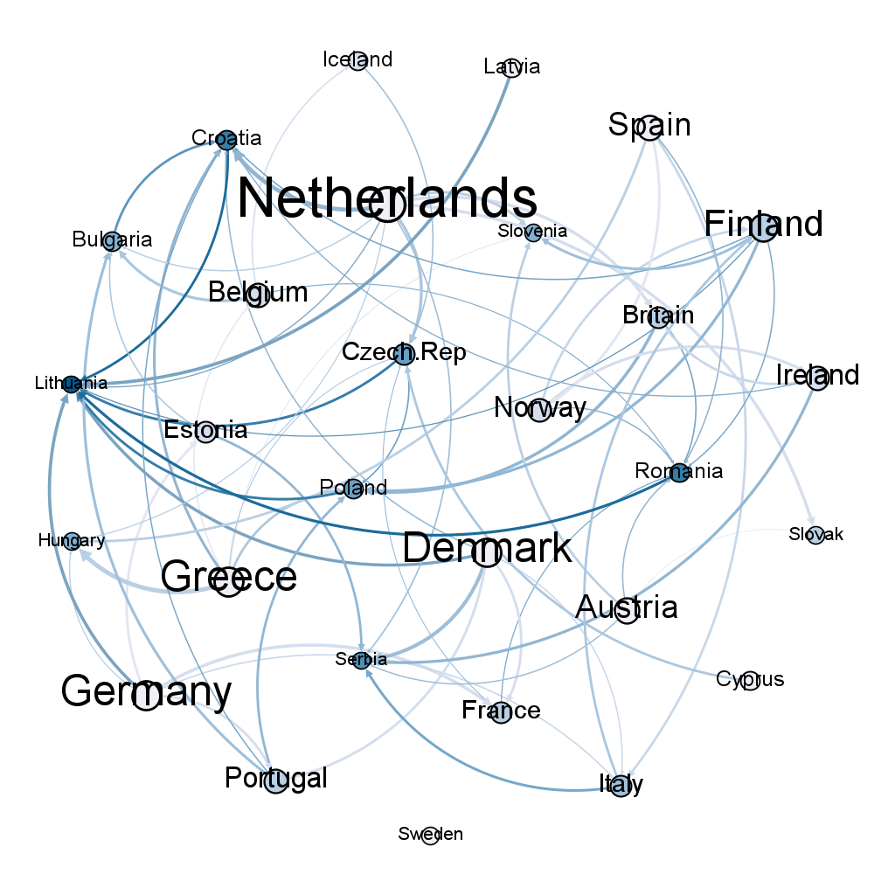
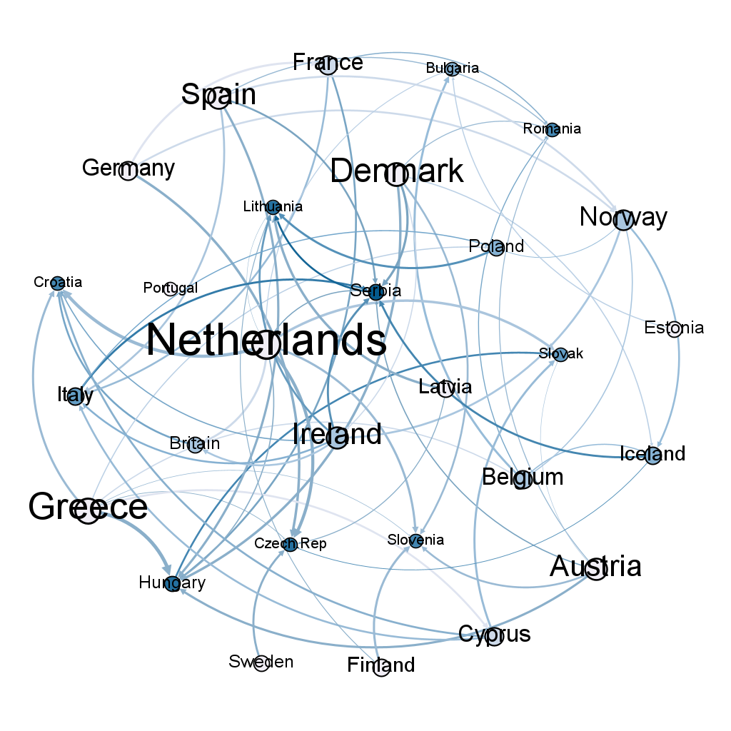
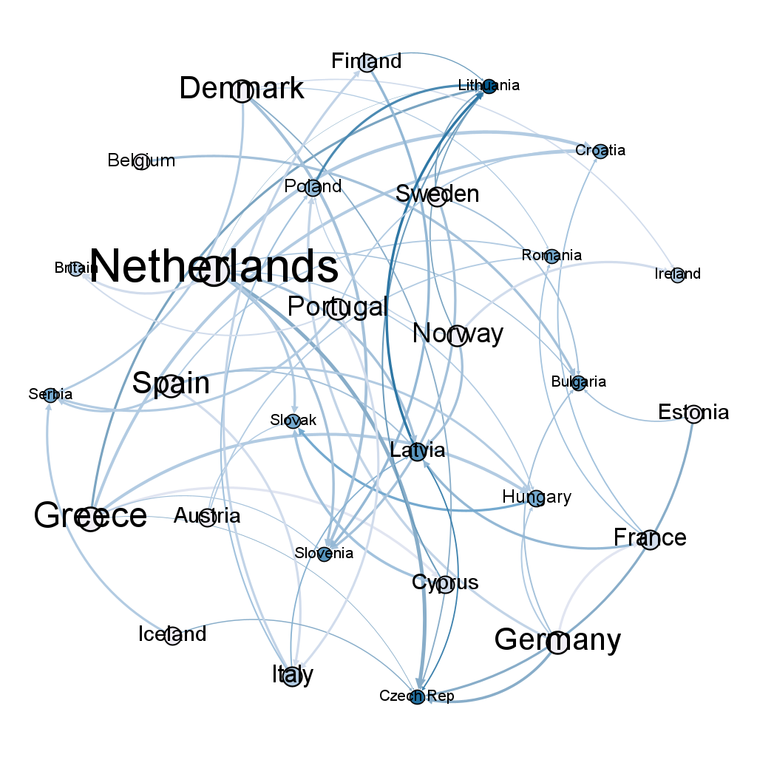
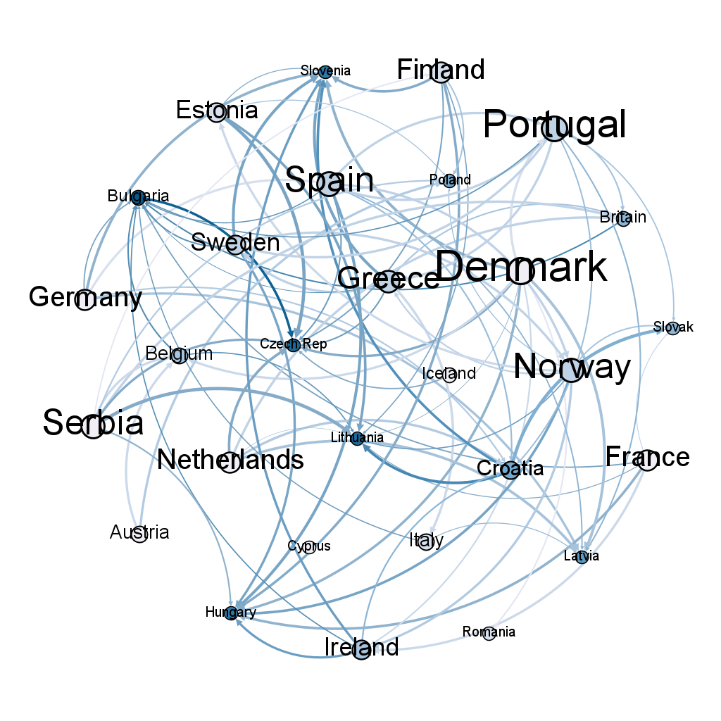
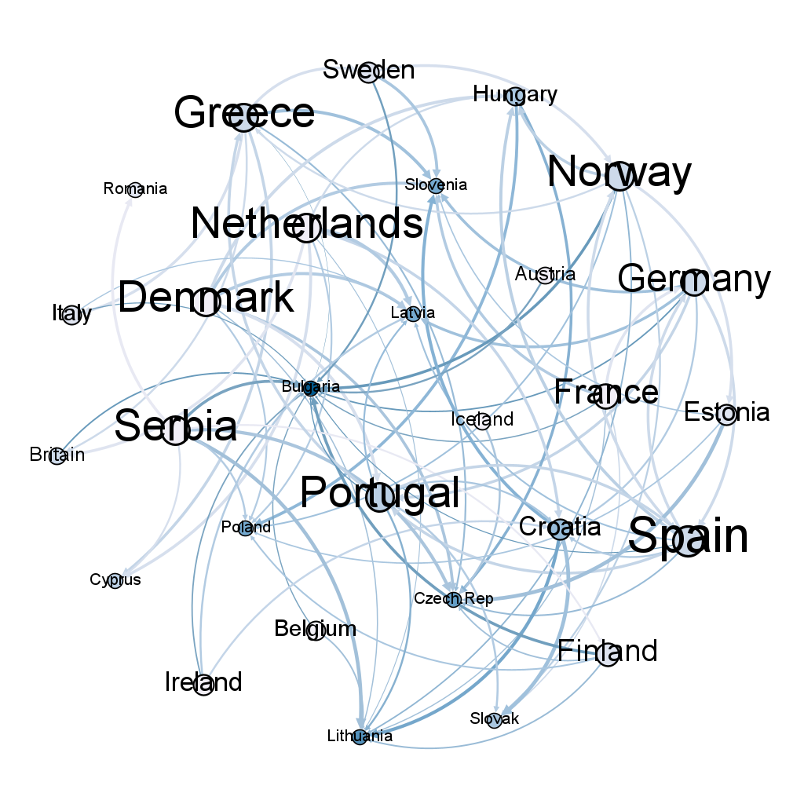
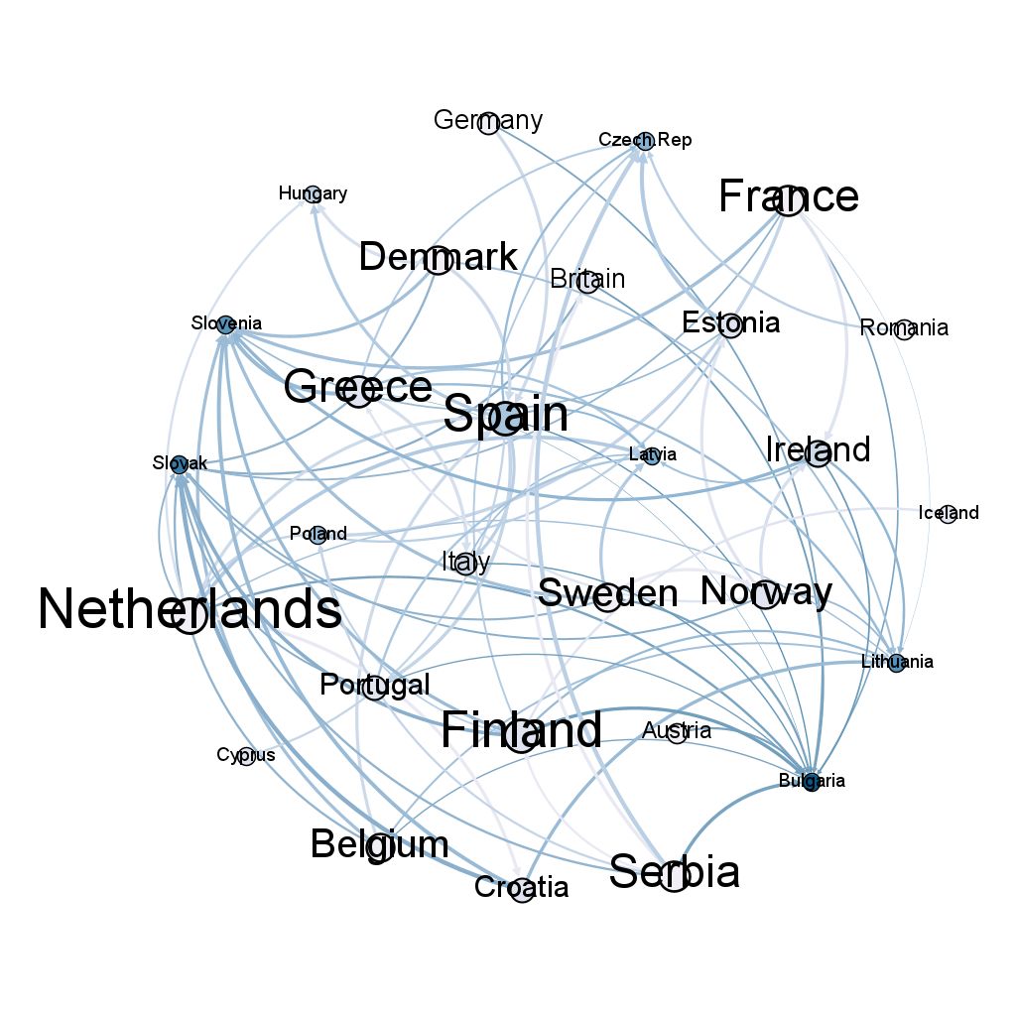
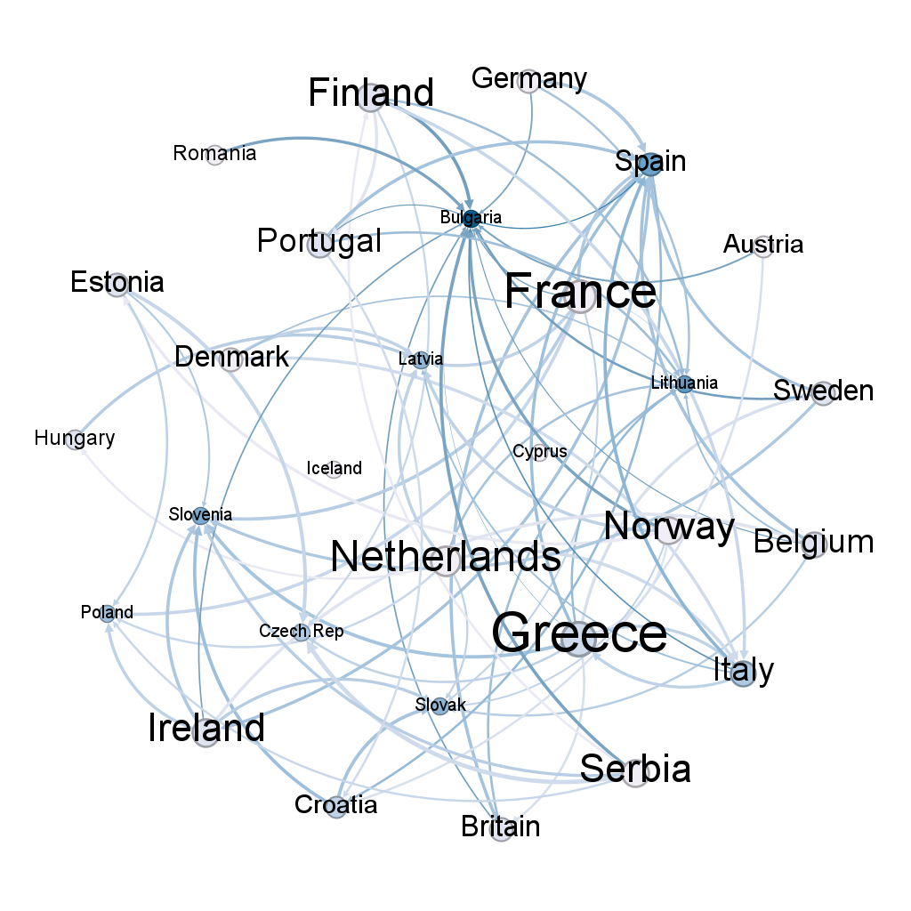
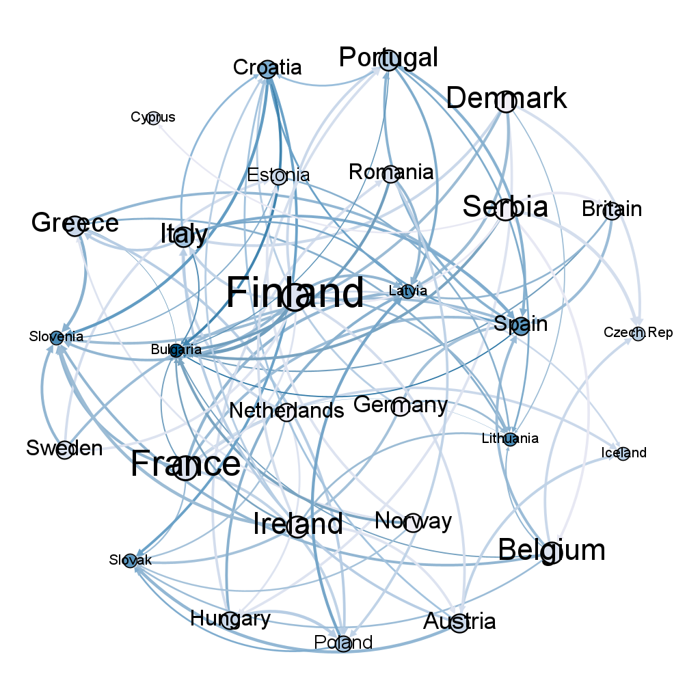
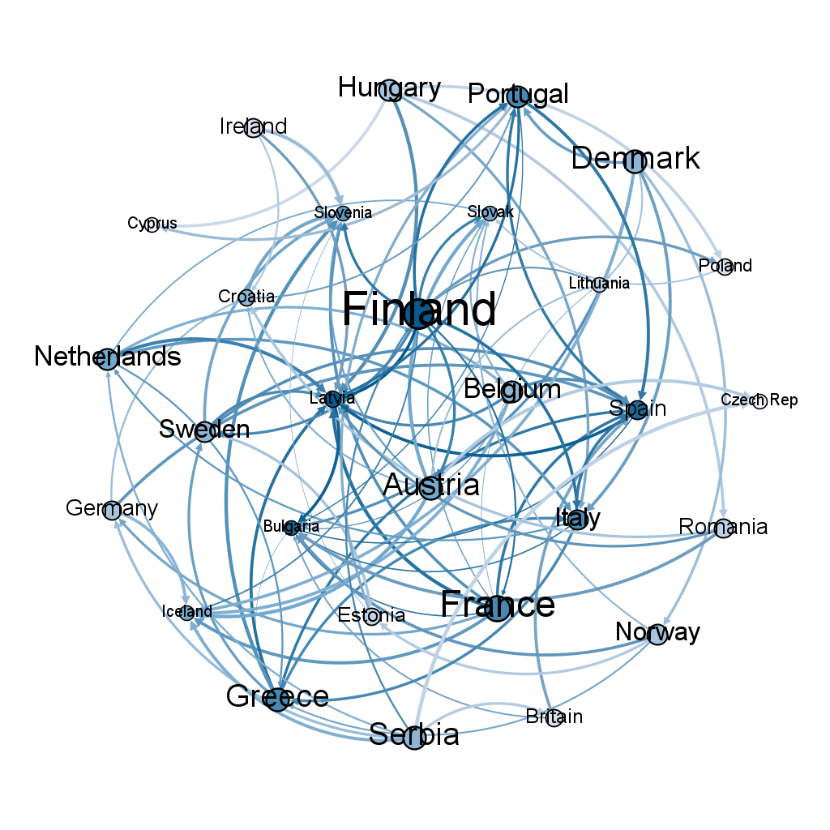
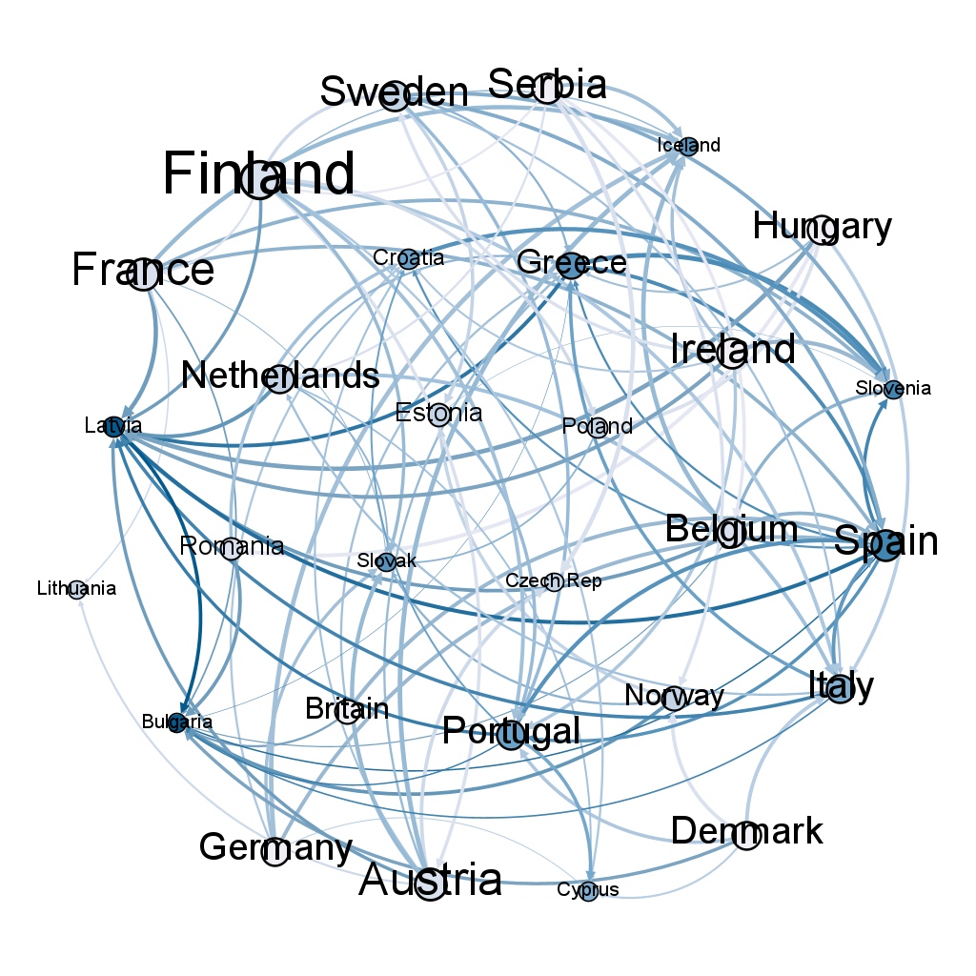
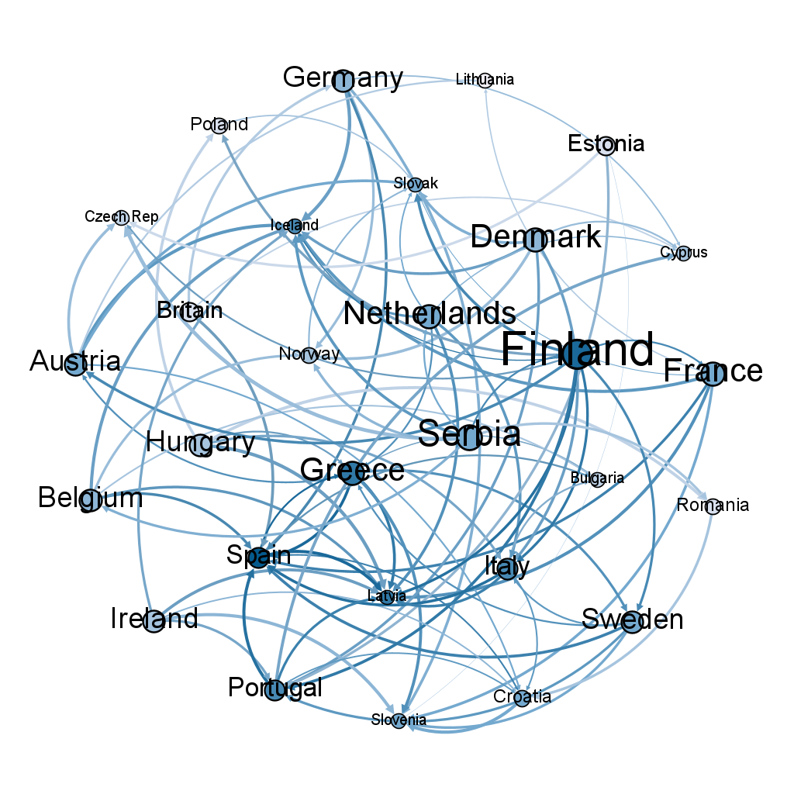
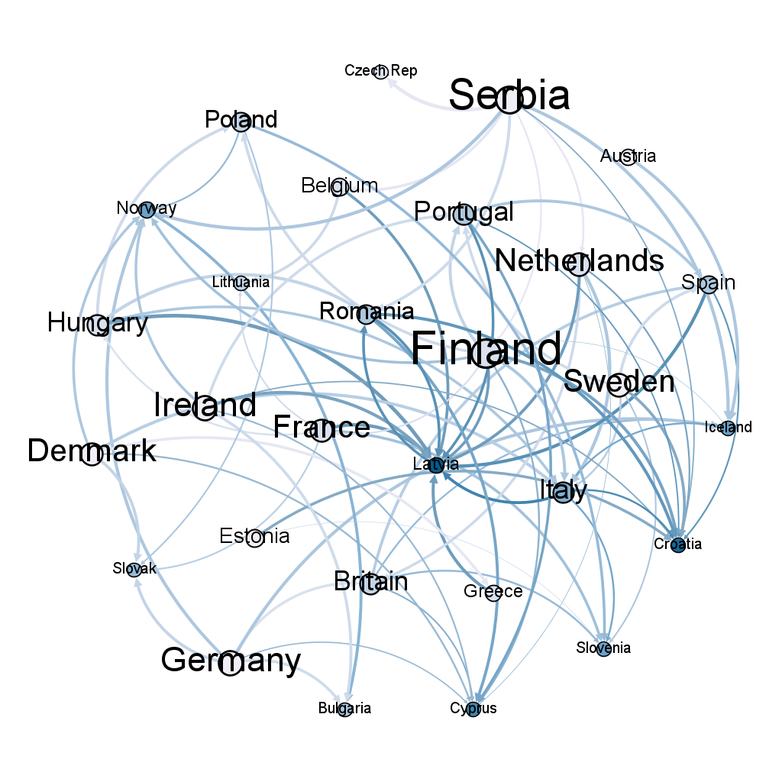
Appendix - Sovereign Networks
2019-01-24
2019-05-30
2019-10-03
2020-02-06
2020-06-12
2020-10-16
2021-02-19
2021-06-29
2021-11-03
2022-03-09
2022-07-13
2022-11-18
2023-03-24
2023-07-28

Slide 14
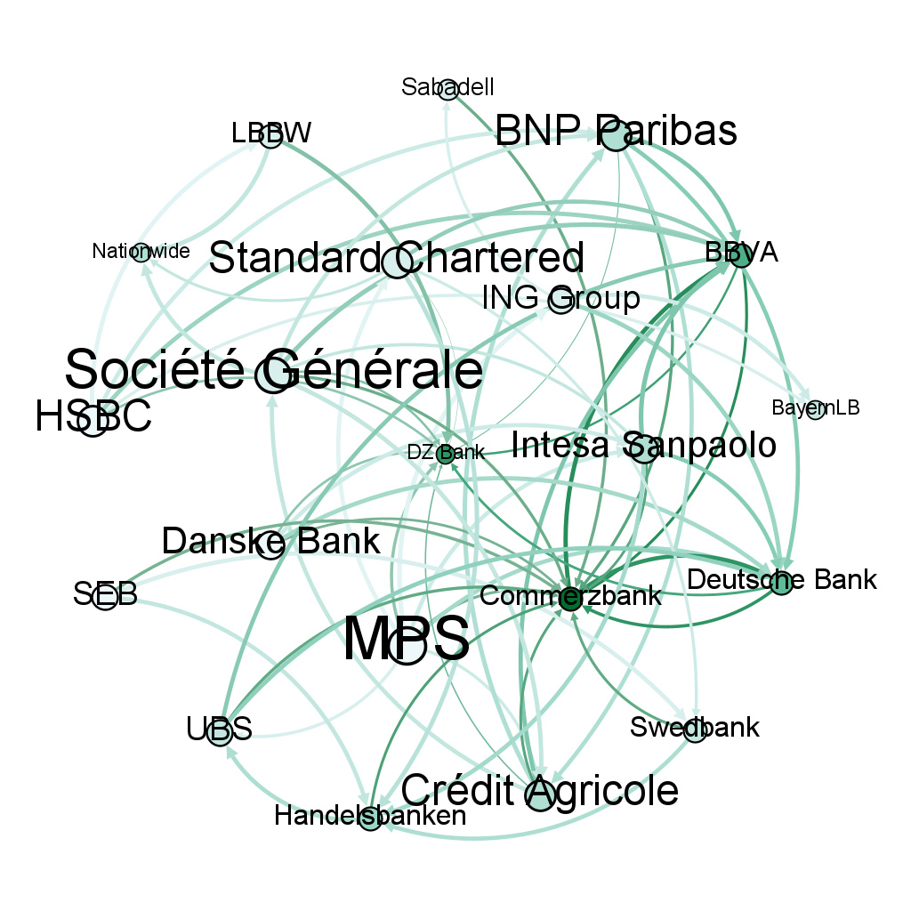
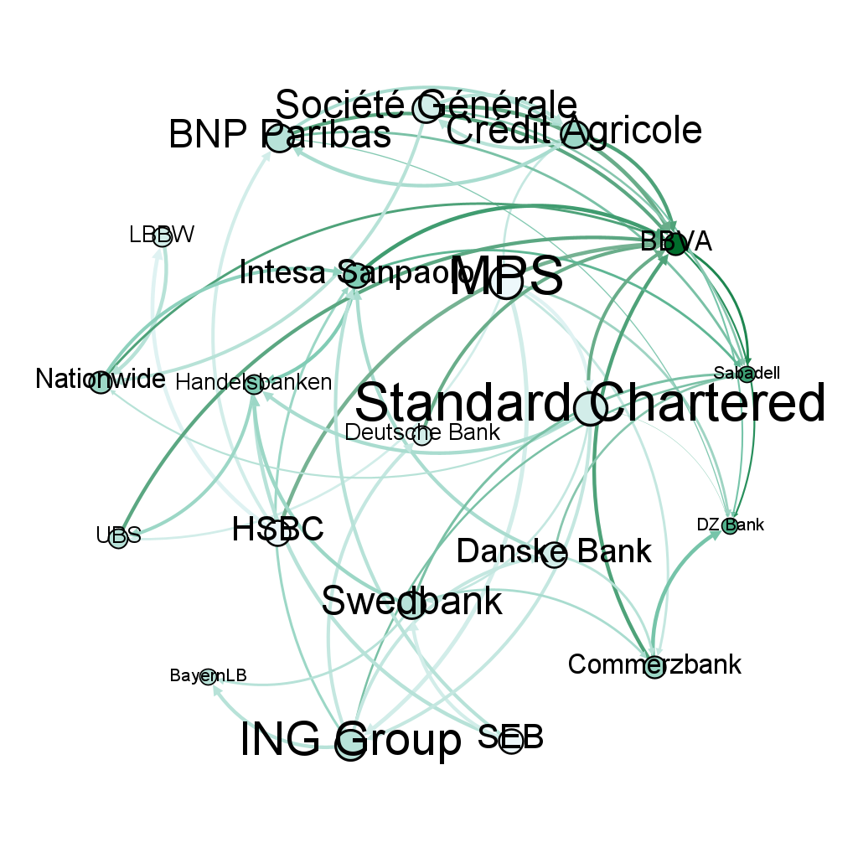
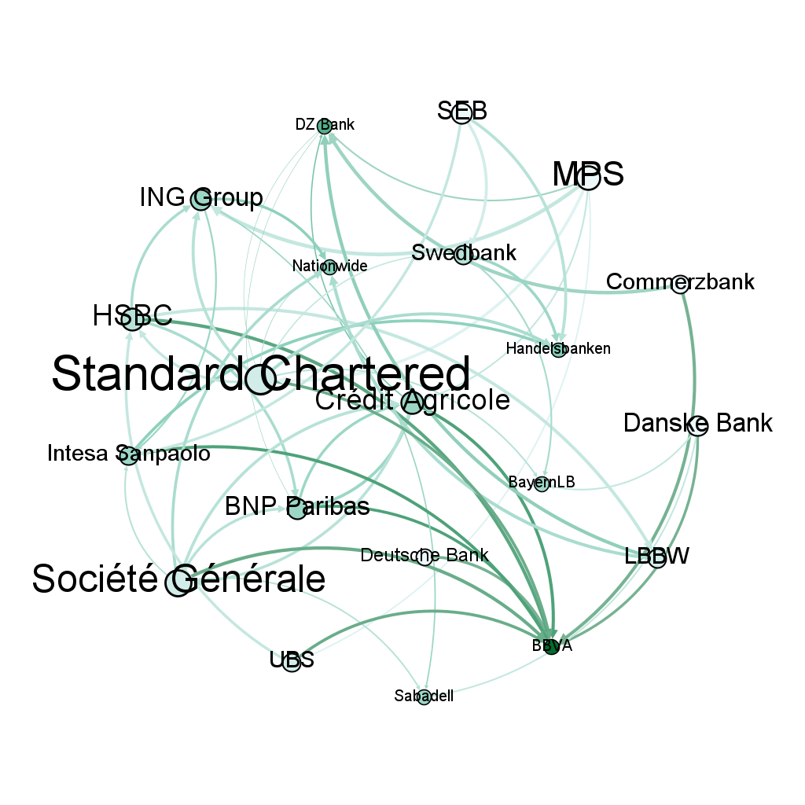
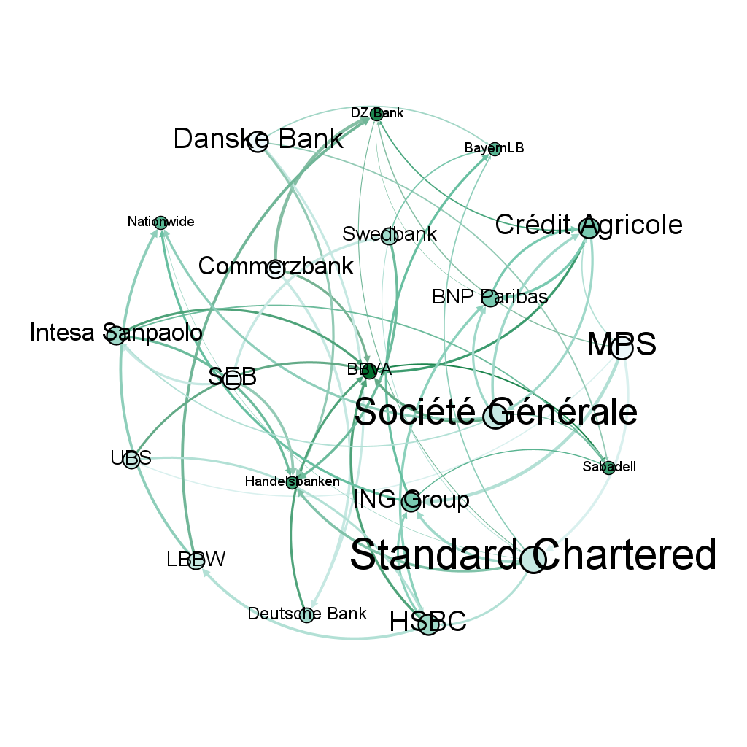
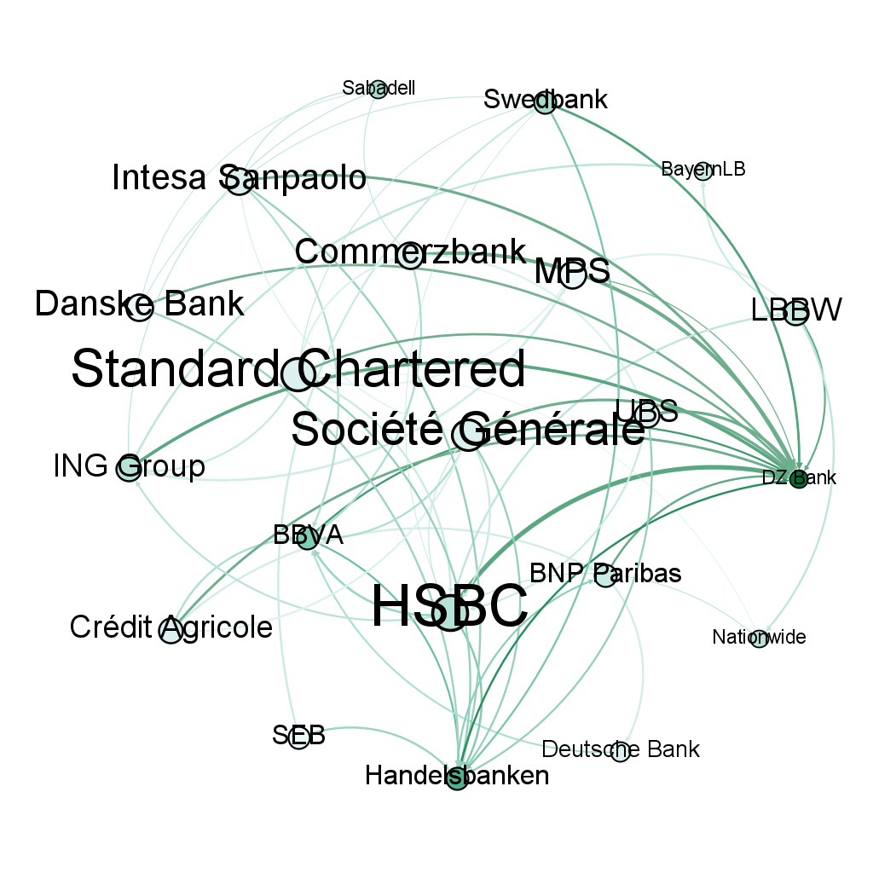
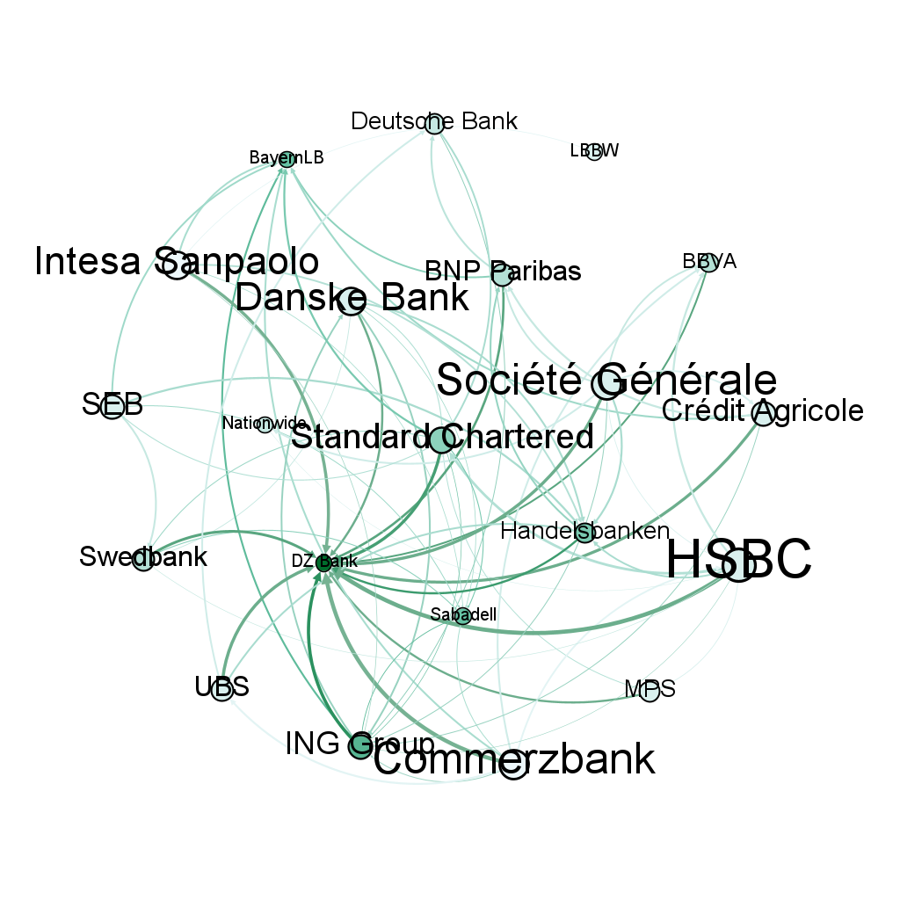
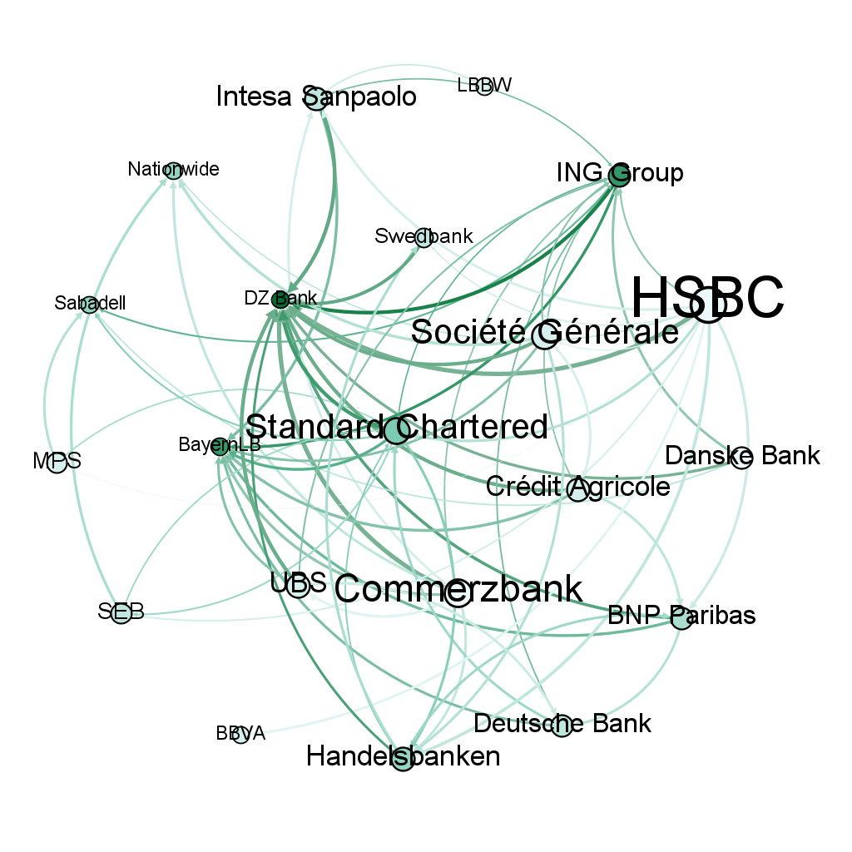
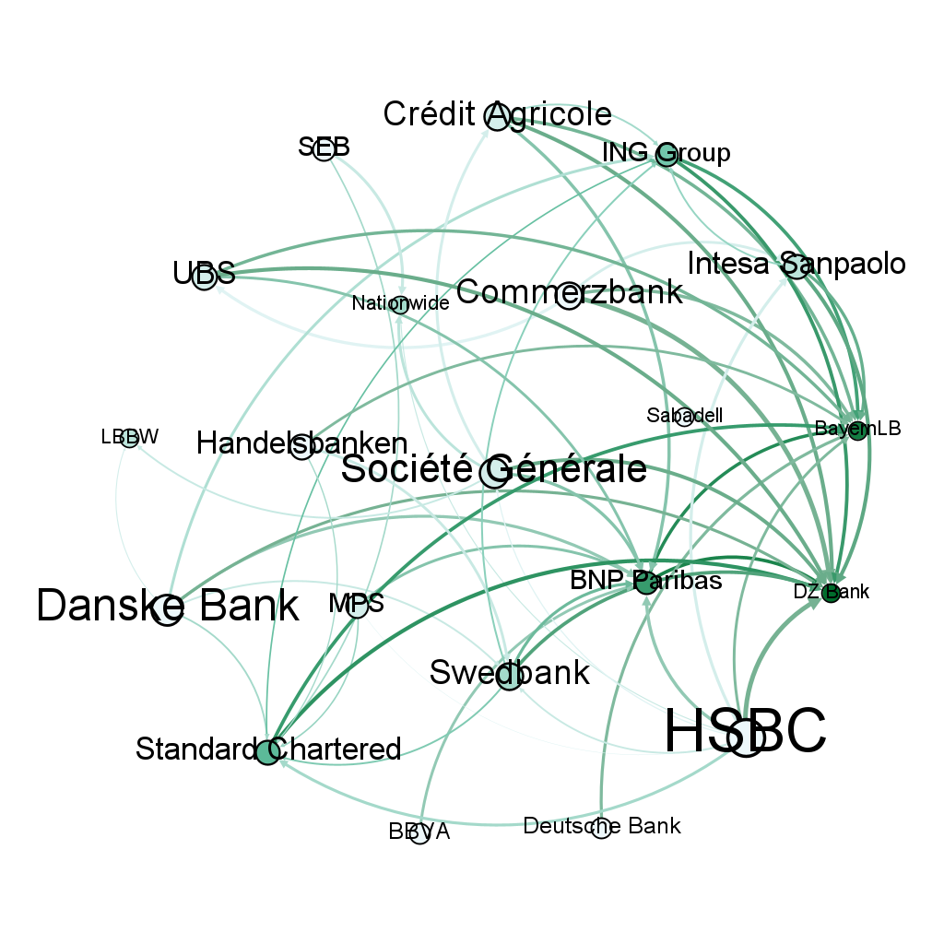
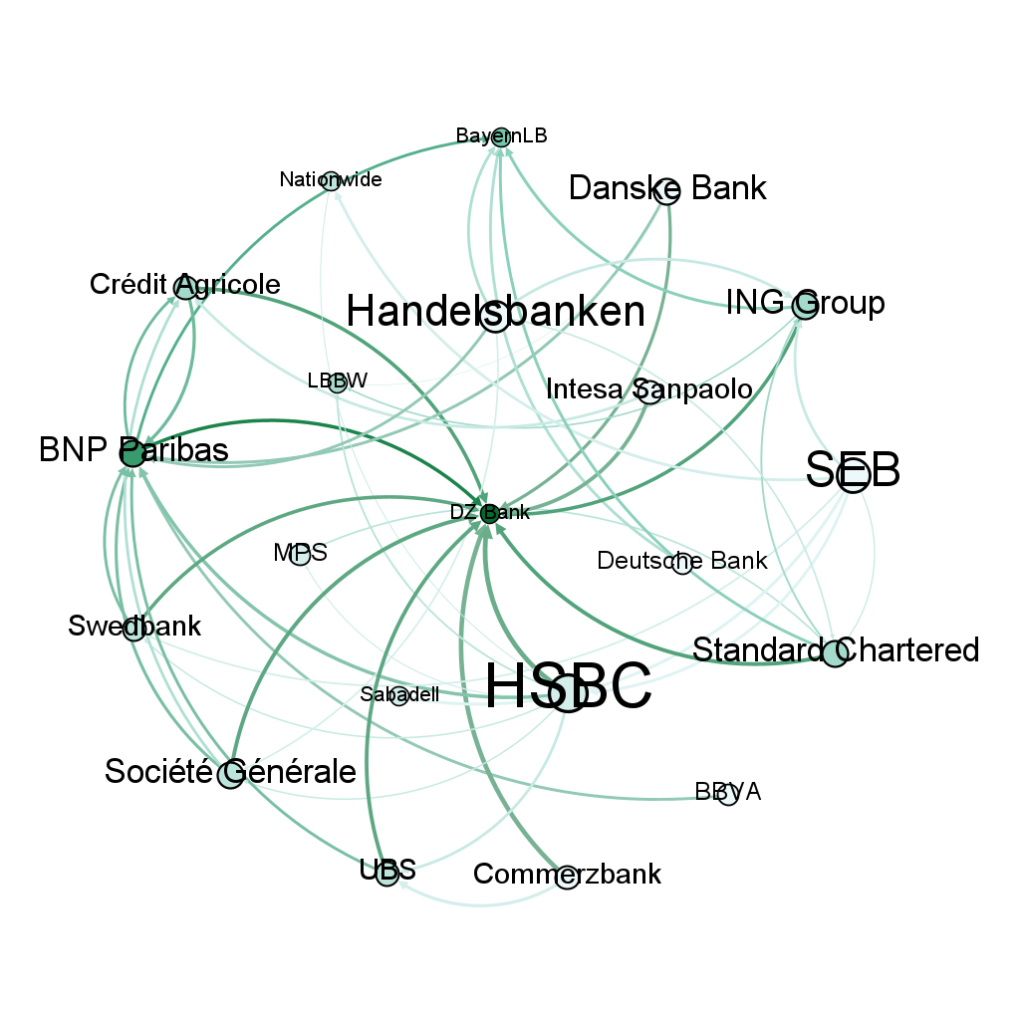
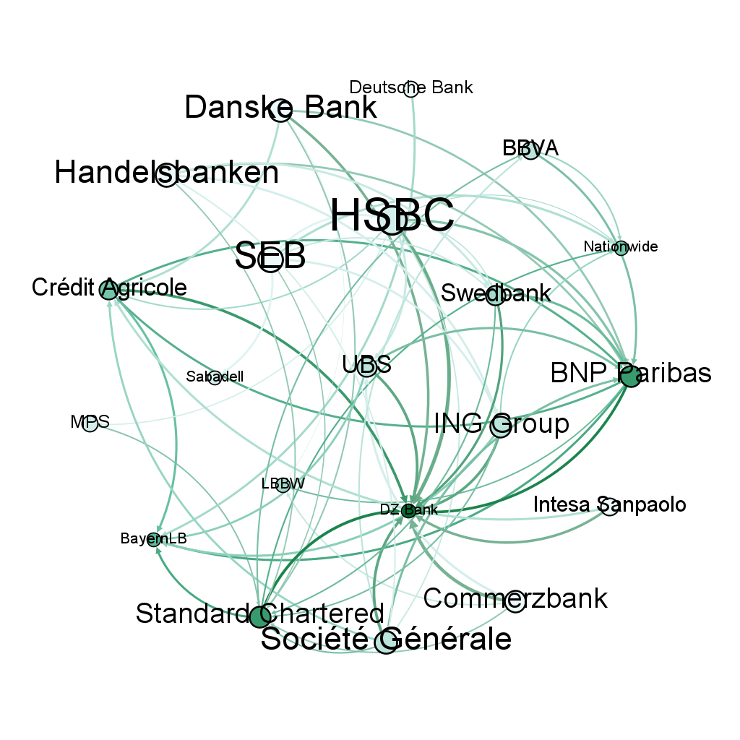
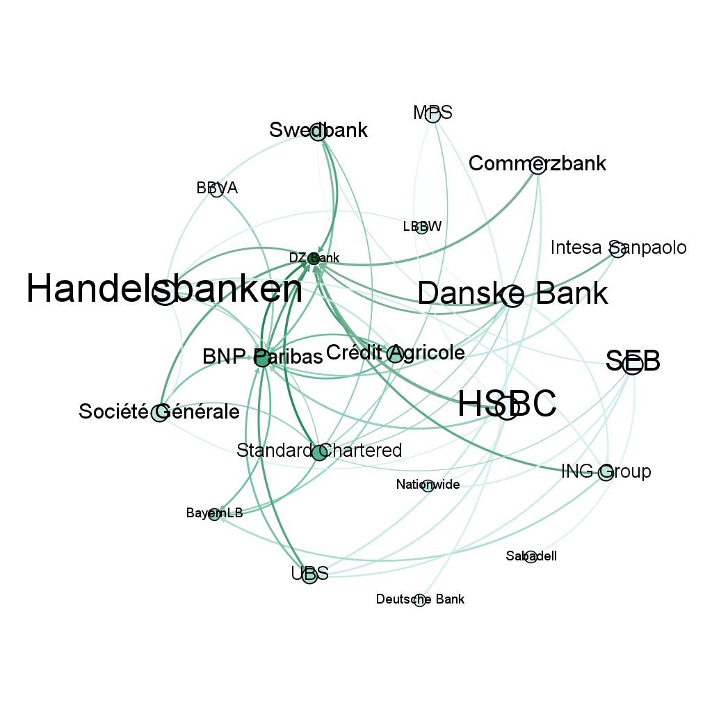
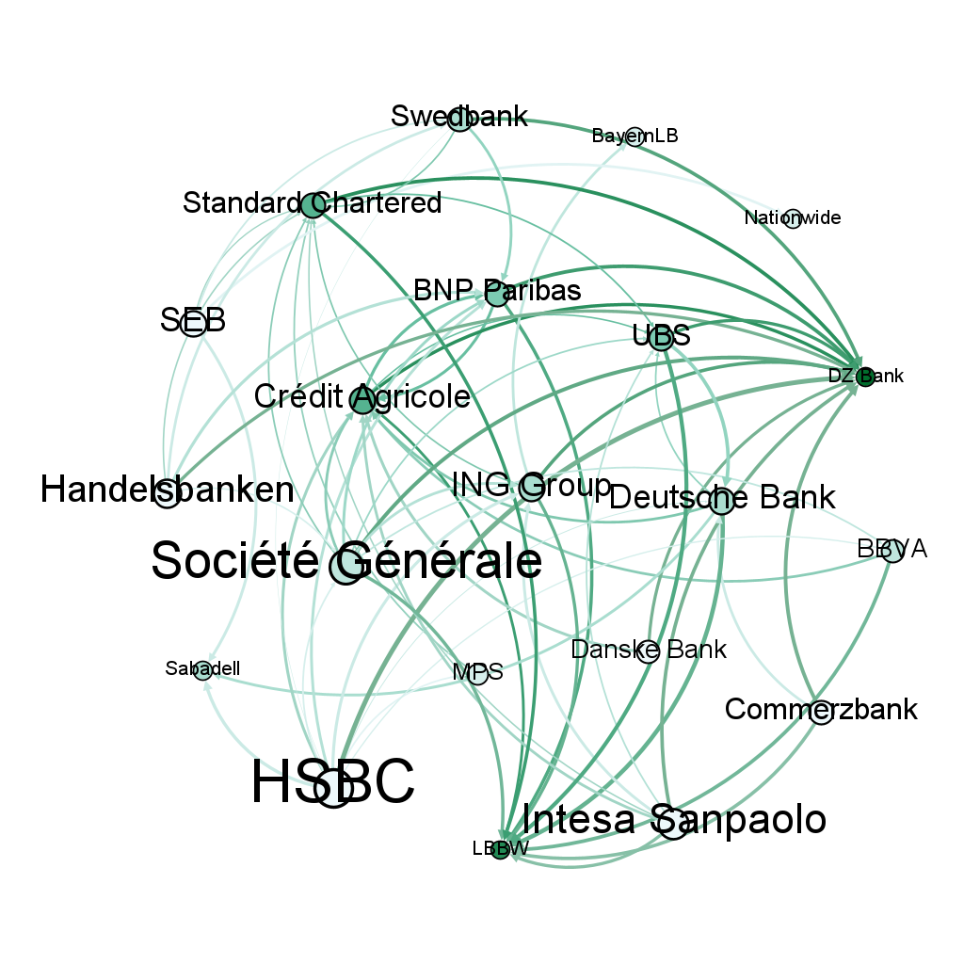
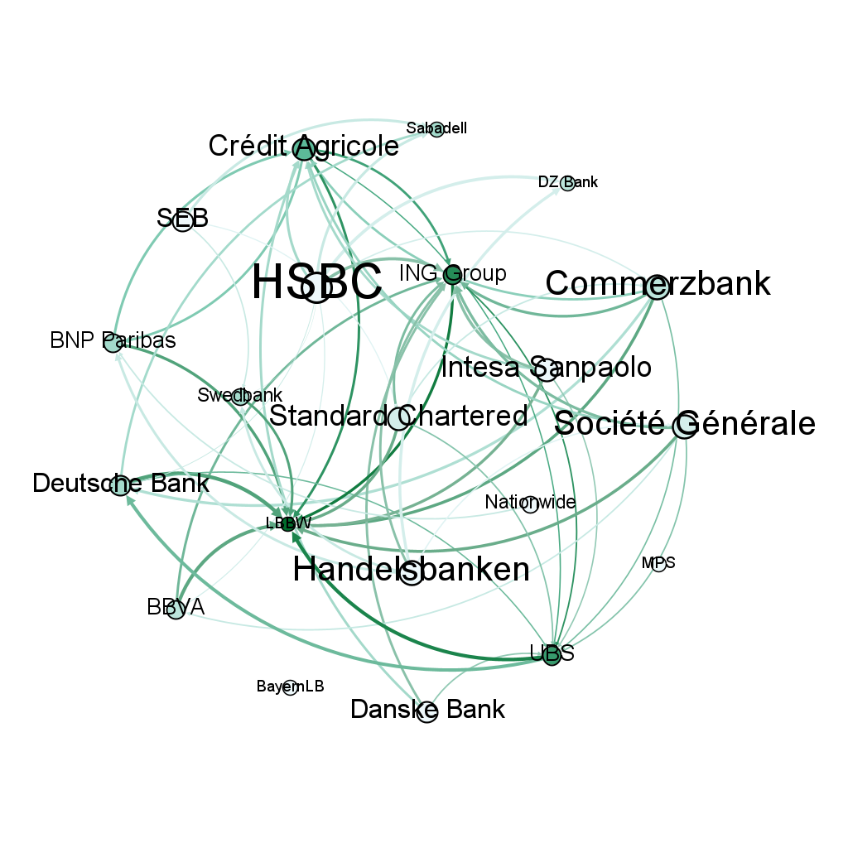
Appendix - Banking Networks
2019-01-24
2019-05-30
2019-10-03
2020-02-06
2020-06-12
2020-10-16
2021-02-19
2021-06-29
2021-11-03
2022-03-09
2022-07-13
2022-11-18
2023-03-24
2023-07-28

